Slide 1
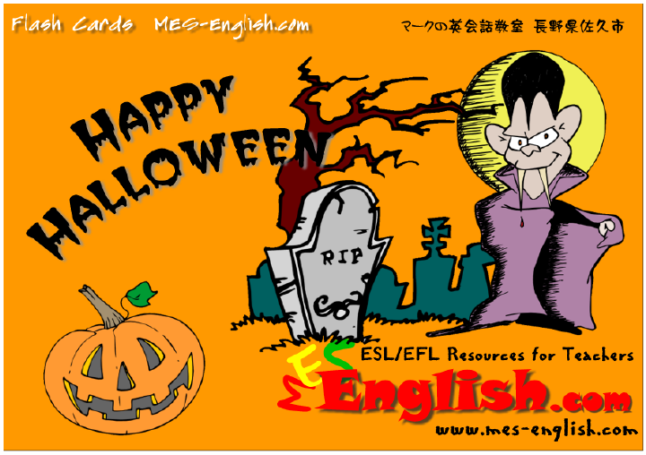
Copyright © 2005 – 2006 MES-English.com

Slide 2
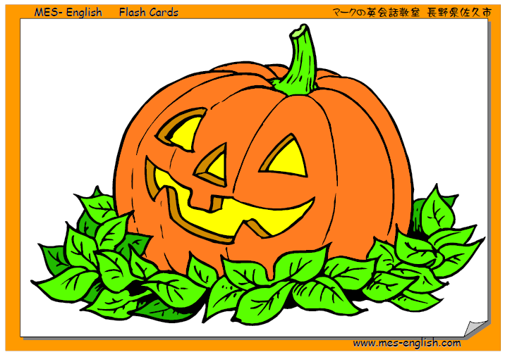
Jack o’ Lantern / Pumpkin

Slide 3
trick or treat

Slide 4
candy

Slide 5
spider web

Slide 6
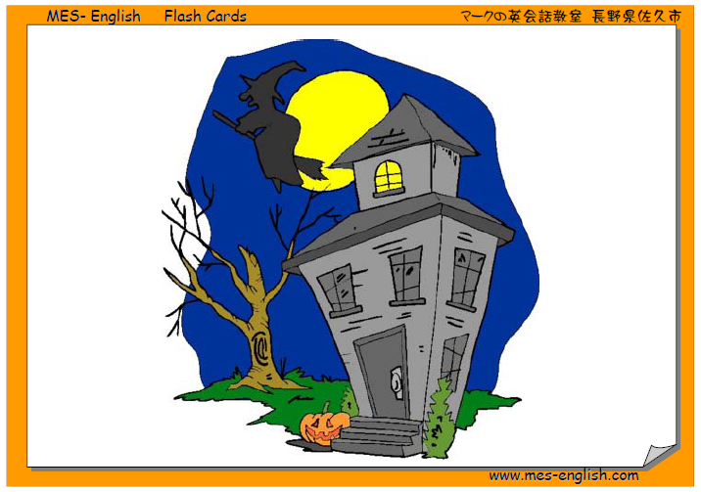
haunted house

Slide 7
black cat

Slide 8
bat

Slide 9
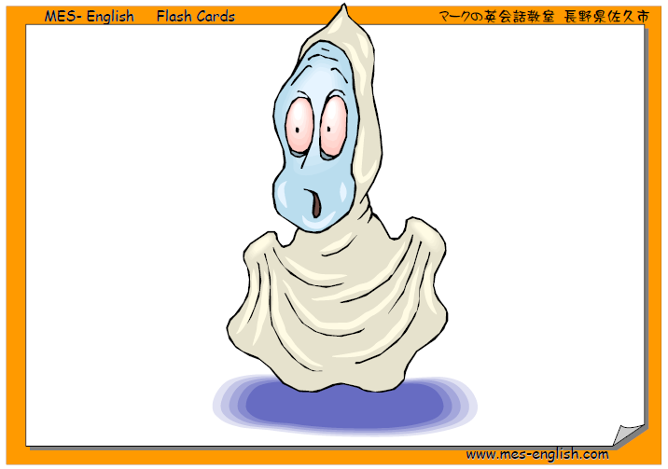
ghost

Slide 10
witch

Slide 11
spider

Slide 12
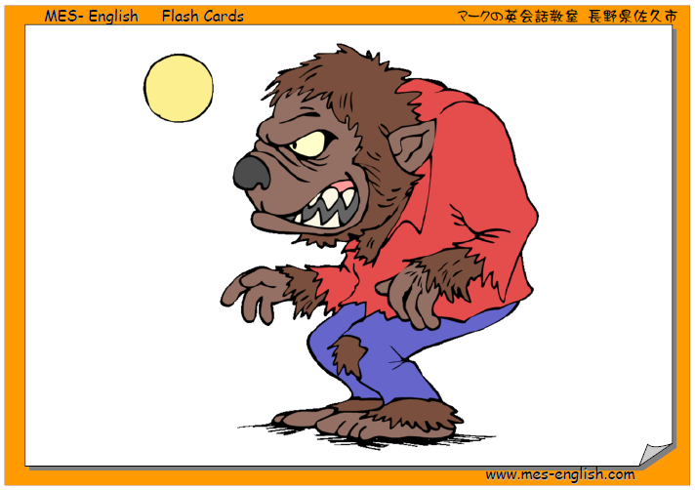
werewolf

Slide 13
skeleton

Slide 14
coffin

Slide 15
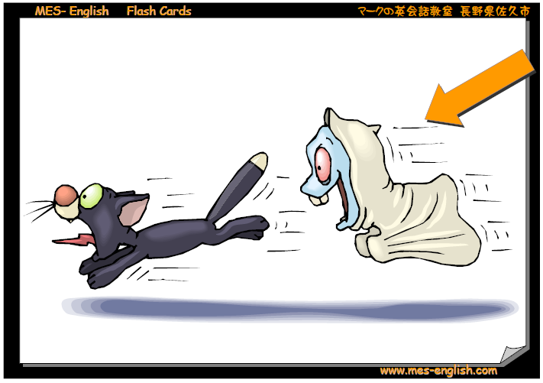
scary

Slide 16
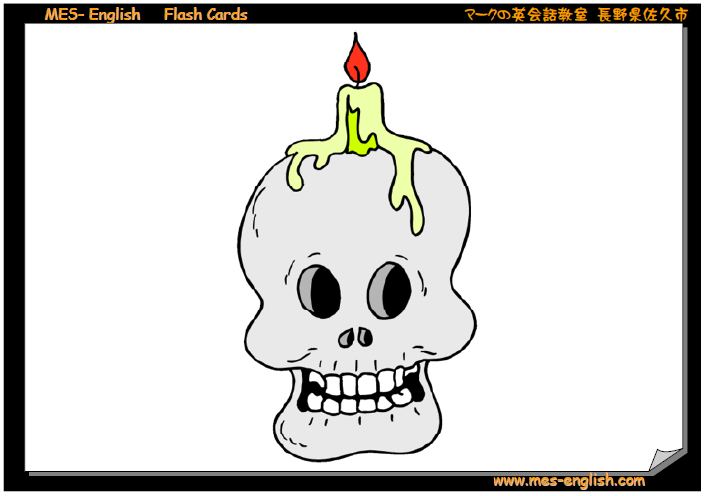
skull

Slide 17
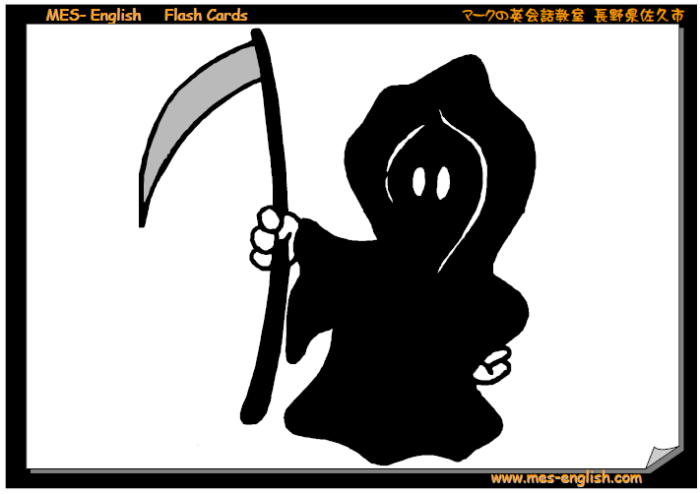
Grim Reaper

Slide 18
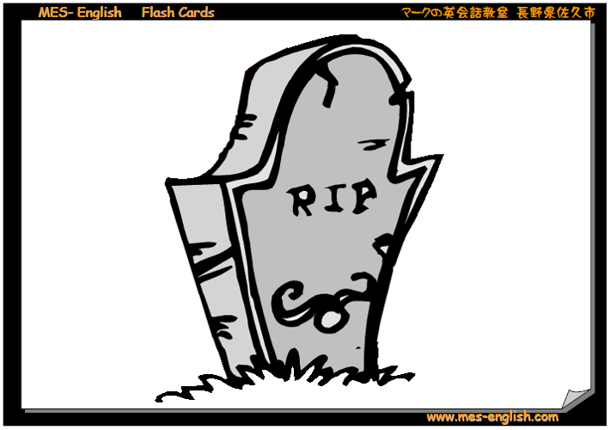
tombstone

Slide 19
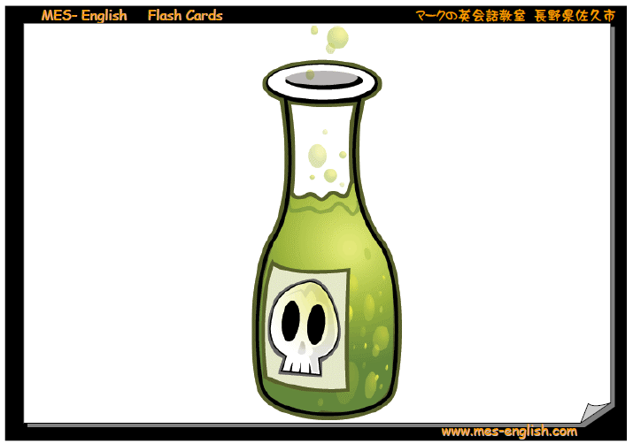
poison

Slide 20
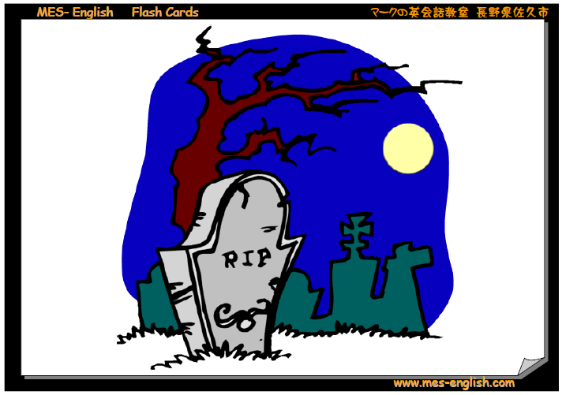
grave yard

